Slide 1
Stakeholders satisfaction measurement for improvement of quality management system of Polish technical universities
Jan Paweł Szefler MSc Eng.

Slide 2
Plan narracji
Dlaczego warto zająć się tematem?: uniwersytety są „silnikiem” rozwoju społecznego, gospodarczego i kulturowego¹ , pozycja polskich uczelni w świecie nauki nie odpowiada pozycji ani potencjałowi Polski w globalnej gospodarce. Ponadto polscy naukowcy osiągają wiele sukcesów naukowych, które nie są odpowiednio komercjalizowane przez polskie przedsiębiorstwa.
Skąd mogą się brać obecne problemy?: Silna kultura akademicka związana z odwoływaniem się do wielowiekowej tradycji; konflikt tradycja a nowoczesność to często sprzeczność między koncepcją uniwersytetu liberalnego i uniwersytetu przedsiębiorczego, a obecnie także z cechami uniwersytetu społecznie odpowiedzialnego; żadna nie może być w pełni rezalizowana przez różne ograniczenia (w tym regulacje prawne);
Sprzeczne oczekiwania różnych interesariuszy; dziedzictwo wielu wieków tradycji uniwersyteckich potęgujących sprzeczności
utilitarian goal, formulated as development of a method for improving the quality management system of universities, adapted to the specifics of Polish technical universities, using the measurement of satisfaction of various stakeholder groups as one of the indicators of the university’s performance
W Polsce wiele złych skojarzeń z kolejnymi reformami szkolnictwa wyższego
Jednocześnie ogromny potencjał w Polsce dla szkolnictwa wyższego; stale utrzymujące się duże zainteresowanie studiowaniem
[Na obronę: rys. 1 teoria zarządzania jakością – kliento-centryzm]
[Na obronę: rys. 2 „cykliczność” zmian koncepcji uniwersytetu]
[Na obronę: rys. 13 do ilustracji sprzecznych interesów]
[Na obronę: geniusz „i” zamiast tyranii „albo” str. 55]

Slide 3
Intro
Universities as engines for social, economical an cultural development¹
Technical universities has a significant role for the economical growth through creation of innovations for technologies
The subject of this dissertation is quality management and the entities of the research are polish public technical universities
The context of the specificity of organizations such as universities has allowed for the development and proposition of tools, the application of which will be a practical manifestation of stakeholder centrism in organizational management.
Cognitive goal: identify effective methods from the perspective of improving the quality management system, through the measurement and analysis of stakeholder satisfaction levels as an indicator of quality
Utilitarian goal: development of a method for improving the quality management system of universities, adapted to the specifics of Polish technical universities, using the measurement of satisfaction of various stakeholder groups as one of the indicators of the university’s performance

Slide 4
Main part
Universities, due to the complexity of relationships between many groups of people associated with them, often with divergent interests, are a particularly challenging environment for implementing modern, mature quality management systems, which is confirmed by the results of the literature research conducted.
The reasons for this state of affairs are manifold, from certain features typical of academic culture, through the complexity of the structure, to difficulties in defining the customer.
Since the idea of customer centricity lies at the foundation of contemporary quality management philosophies, when the customer cannot be unequivocally identified, the basic goals of quality improvement activities become unclear.
Nowadays, in the context of universities, the concept of the customer is commonly replaced by the concept of stakeholders. Therefore, the author suggests that stakeholder analysis and the measurement of stakeholder satisfaction should form the basis of all improvement actions.

Slide 5
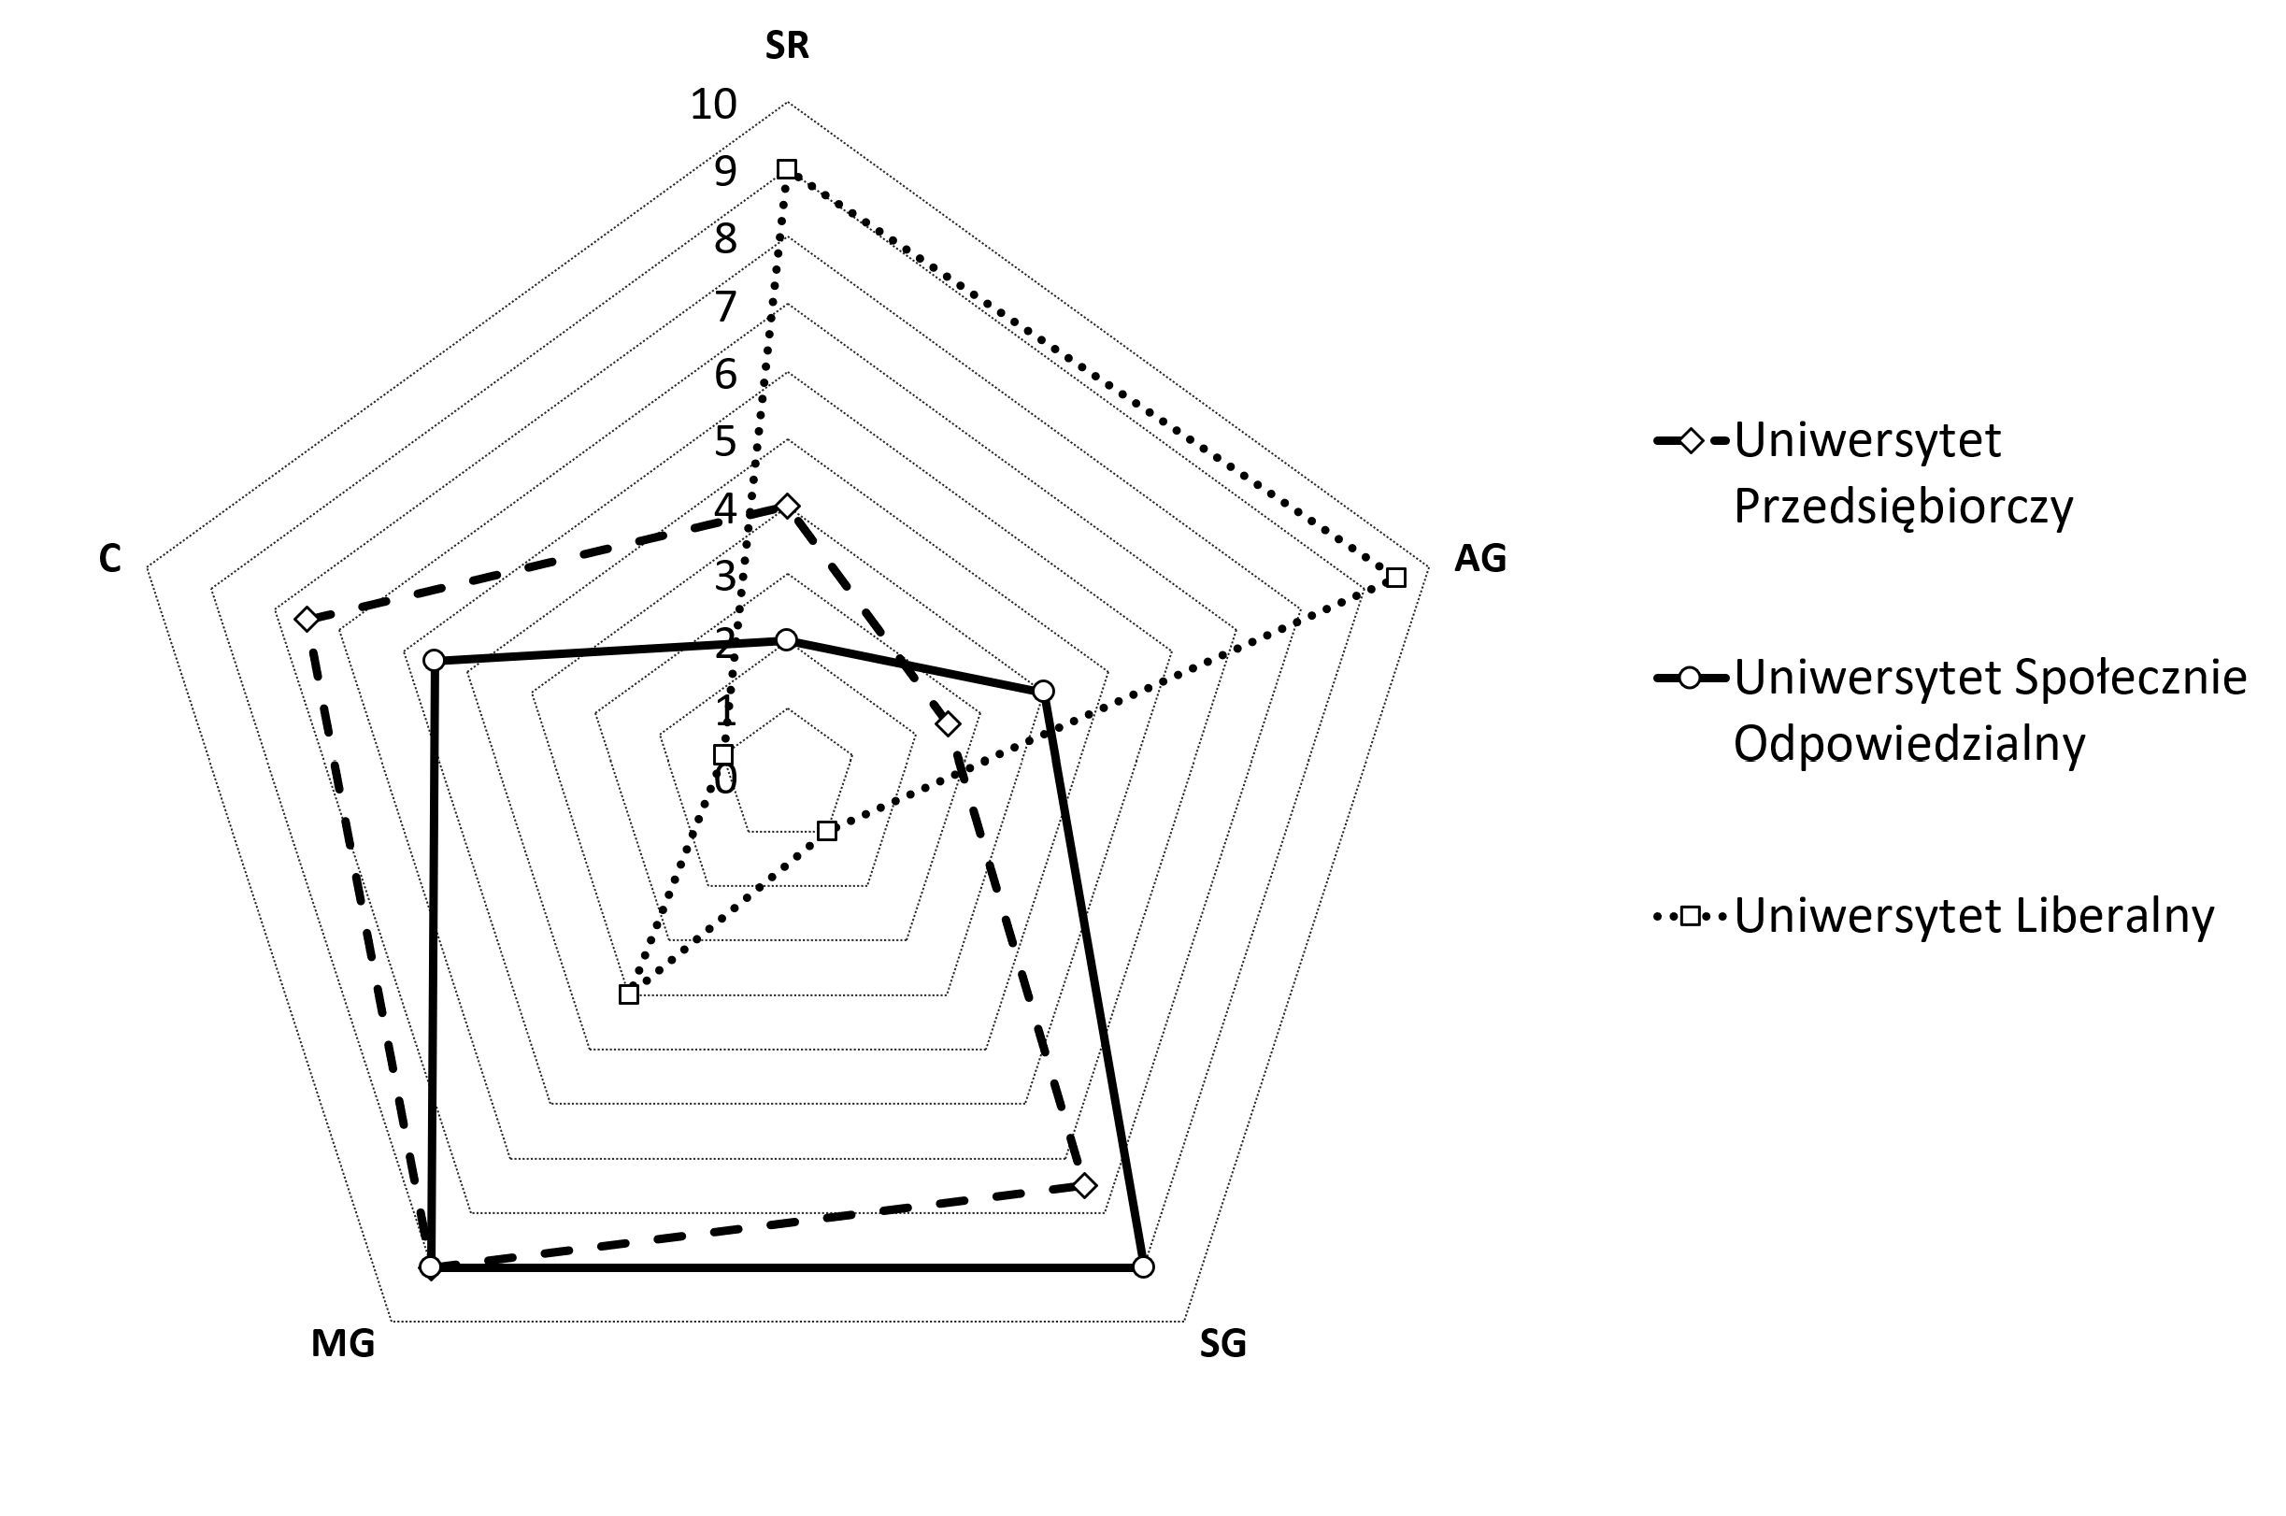
Main concepts for universities - radar
SR – State Regulations
AG – Academic self-Governance
SG – Stakeholder guidance
MG – Managerial self-Governance
C – Competition
Entreprneurial University
Socially Responsible University
Liberal University
² literature: Leja 2011, p. 175

Slide 6
Conflicting interests environment
Przygotować rysunek w draw.io – środowisko relacji uniwersytetu – pol i ang.

Slide 7
Summary
This dissertation contributes to the development of management and quality sciences through synthesis of quality management theory and stakeholder theory.
The conducted qualitative and quantitative research allowed for achieving the cognitive goal of the study, which was to identify effective methods from the perspective of improving the quality management system, through the measurement and analysis of stakeholder satisfaction levels as an indicator of quality.
The utilitarian goal, formulated as development of a method for improving the quality management system of universities, adapted to the specifics of Polish technical universities, using the measurement of satisfaction of various stakeholder groups as one of the indicators of the university’s performance, was also achieved.
This objective has been achieved with developing Stakeholders Satisfaction Driven Quality Management Model – SSDQM.
The model is developed taking into account possible applications in the context of the specifics of Polish technical universities.
The applicative value of the proposed model has been enhanced with recommendations resulting from the conducted research, a significant part of which is the development of a basic set of indicators.
These are measures statistically proven to be significant for the environment of technical universities.
The strong connections of the proposed model with the field of quality management are also confirmed by analyses indicating that the application of SSDQM can provide very good preparation for organizations to implement the requirements of the ISO 21001:2018 and other standards and requirements that promote focus on stakeholders.

Slide 8
Literature
1. Puente et al. 2021

